Slide 1
RDBMS
. RDBMS stands for Relational Database Management System. RDBMS is the basis for SQL, and for all modern database systems such as MS SQL Server, IBM DB2, Oracle, MySQL, and Microsoft Access. The data in RDBMS is stored in database objects called tables.

Slide 2
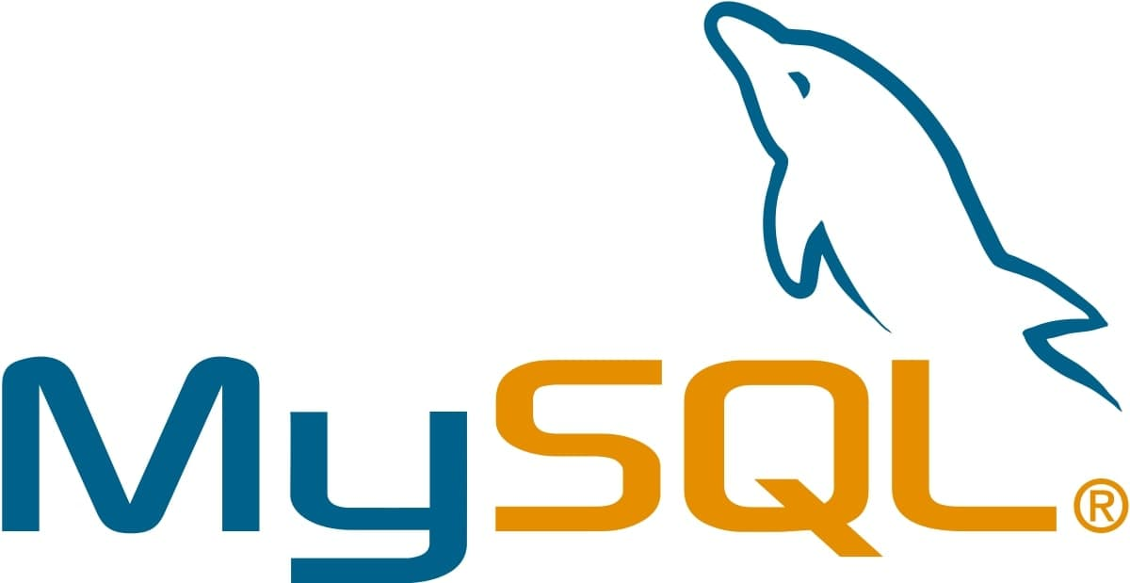
MySQL

Slide 3
MySQL is a relational database management system (RDBMS) based on the SQL (Structured Query Language) queries. It is one of the most popular languages for accessing and managing the records in the table. MySQL is open-source and free software under the GNU license.

Slide 4
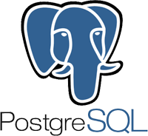
PostgreSQL

Slide 5
PostgreSQL is a powerful, open source object-relational database system that uses and extends the SQL language combined with many features that safely store and scale the most complicated data workloads.

Slide 6
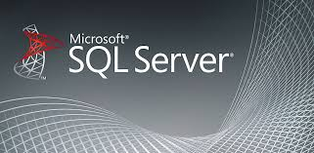
SQL SERVER

Slide 7
SQL Server Function Types SQL Server supports two types of functions - user-defined and system. User-Defined function: User-defined functions are create by a user. System Defined Function: System functions are built-in database functions.

Slide 8
 | MySQL | PostgreSQL | SQL Server
JSON data type | MySQL has JSON data type support and also supports in place partial updates over the JSON instead of replacing the whole document however there are many limitations. It does not support indexing for JSON but there are workarounds. | PostgreSQL supports JSON data type and supports partial updates | PostgreSQL supports JSON data type and supports partial updates
Additional Advanced data types | Supports Geospatial data type. No user-defined types. | Supports Geospatial and lots of advanced data types, such as multi-dimensional arrays, user-defined types, etc | Supports Geospatial data type, Hierarchical data

